Slide 1
Presentation brief for MCT’s
Title of presentation | Data engineering considerations for source files
Presentation\Lab length | Presentation: 15 - 20 minutes Lab: 50 – 60 minutes
Audience | Data Engineers, Data Scientists, Data Professionals, Data Architects, BI Professionals, Developers
Purpose | Introduce the concept of a modern data warehouse (MDW) architecture Understand the files and folder structures used in a MDW and which one is appropriate Have a high-level overview and understanding of security
(think) Student key takeaways | The student should understand the files type that are used in a data warehouse The student should understand why folder structures are important to optimize a MDW The student should be aware of key security consideration for a MDW in Azure Synapse Analytics
(feel) Student desired mindset | The student may feel that an MDW can contain many technologies The student may feel confusion about the files types that should be used at each part of the MDW process The student may feel overwhelmed about security, explain this is the first of three modules that cover it
(do) Student outcomes | The student should be able to describe the MDW architecture and processes The student should be able to explain the different file types and how organizing folders is important The students should be able to understand security at a high level
More information | For MCT course feedback, visit the Microsoft Official Courseware forum
Notes:
Instructor notes and guidance.
This slide is for MCT use only, outlining the aims and objectives of this module.

Slide 2
DP-203T00: Data engineering considerations for source files
Notes:
Instructor notes and guidance.
In this module, you will provide an overview of the modern data warehouse (MDW) architecture pattern, and the security that protects the data warehouse. The design principal for this module is that we are encouraging approximately 20 minutes of teaching followed by 20 minutes of individual/group work, followed by 40 minutes of class discussion. The questions in the labs are design to promote discussion to validate that the students are comfortable with a Modern Data Warehouse architecture pattern, and that they have a high-level understanding of security. It gives you the opportunity to gauge the knowledge level of the group, especially given the in-depth overview provided in module 1 and 2. There is a specific focus on files in this module, as there is a lack of understanding of when it is appropriate to use CSV versus parquet, this can help frame the discussion around the MDW process too.

Slide 3
Agenda
Lesson 01: Design a Modern Data Warehouse using Azure Synapse Analytics
Lesson 02: Secure a data warehouse in Azure Synapse Analytics
Notes:
Instructor notes and guidance.
This space has been left deliberately blank

Slide 4
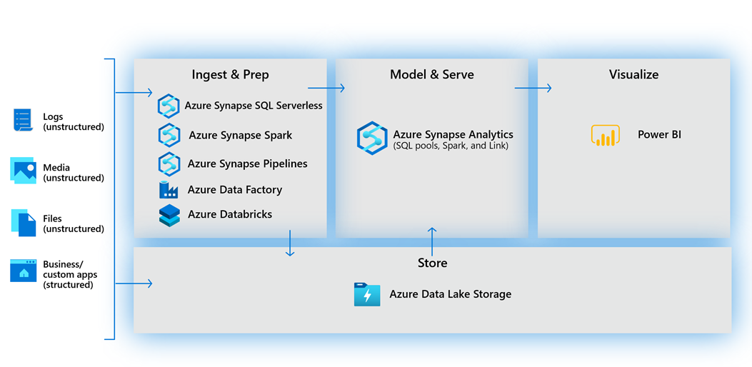
Design a Modern Data Warehouse using Azure Synapse Analytics
Notes:
Talking point
The process of building a modern data warehouse typically consists of:
Data Ingestion and Preparation.
Making the data ready for consumption by analytical tools.
Providing access to the data, in a shaped format so that it can easily be consumed by data visualization tools.
You can either use Azure Synapse exclusively, which works well for green field projects. But for organizations with existing investments in Azure with Azure Data Factory, Azure Databricks and Power BI, you can take a hybrid approach and combine them with Azure Synapse Analytics.
At the foundation, customers build a data lake to store all their data and different data types with Azure Data Lake Store Gen2.
To ingest data, customers can do so code-free with over 100 data integration connectors with Azure Data Factory/Azure Synapse Pipelines. Data Factory empowers customers to do code-free ETL/ELT, including preparation and transformation. Another option for data preparation is Azure Databricks - to shape the data formats and prep it using a Notebook—making internal collaboration on data more streamlined and efficient.
At the heart of a modern data warehouse, and cloud scale analytical solution is Azure Synapse Analytics. This implements a data warehouse using a dedicated SQL pool that leverages the Massively Parallel Processing engine that brings together enterprise data warehousing and Big Data analytics.
Power BI enables customers to build visualizations on massive amounts of data and ensures that data insights are available to everyone across their organization.
Instructor notes and guidance.
It’s important to stress to the students that a modern data warehouse pattern is technology agnostic, so you can build a solution using a variety of technologies. This course will focus on the Microsoft technologies that can be used to build a modern data warehousing pattern. In the recommended reading for this slide, pay close attention to the content on Understand file formats and structure for a modern data warehouse. This has an impact on the performance of working with data in the data warehouse.
Recommended reading for this slide
Design a Modern Data Warehouse using Azure Synapse Analytics - Learn | Microsoft Docs

Slide 5
Securing a data warehouse in Azure Synapse Analytics
Network security options
Configuring authentication
Managing authorization
Managing sensitive data with Dynamic data masking
Implement encryption
Notes:
Talking point
There are a range of network security steps that you should consider to secure Azure Synapse Analytics. One of the first aspects that you will consider is securing access to the service itself. This can be achieved by creating the following network objects including:
Firewall rules
Virtual networks
Private endpoints
Authentication is the process of validating credentials as you access resources in a digital infrastructure. This ensures that you can validate that an individual, or a service that wants to access a service in your environment can prove who they are. Azure Synapse Analytics provides several different methods for authentication. You can manage authorization through column and row level security within Azure Synapse Analytics. If you are using Azure Databricks then you are relying on the Data Lake security.
Dynamic Data Masking is masking and ensures limited data exposure to non-privileged users, such that they can't see it. It also helps you in preventing unauthorized access to sensitive data.
Encryption can include Transparent Data Encryption. Transparent data encryption (TDE) is an encryption mechanism to help you protect data within Azure Synapse Analytics, and Azure Data Lake. It will protect the data against threats of malicious offline activity. The way TDE will do so, is by encrypting data at rest.
Instructor notes and guidance.
Its important to stress to the students that this lesson is introducing them to the security areas that they need to be concerned with when building analytical solutions, and that they will be looking at this in a couple of modules. So, if the students doesn’t take everything in at this module, then there is opportunity for reinforcement of the information later.
Recommended reading for this slide
Secure a data warehouse in Azure Synapse Analytics - Learn | Microsoft Docs

Slide 6
Review questions
Q01 What are the four process phases for processing data in a Modern Data Warehouse?
A01 – Store, Ingest and Prep, Model and Serve, Visualize
Q02 – Which file format is the best for storing refined versions of the data for querying?
A02 – Parquet
Q03 – What security option can be used to prevent unauthorized access to sensitive data?
A03 – Dynamic data masking
Notes:
Instructor notes and guidance.
This space has been left deliberately blank

Slide 7
Lab: Data engineering considerations for source files
Notes:
Instructor notes and guidance.
This space has been left deliberately blank

Slide 8
Lab overview
In this lab, you will be directed by your instructor to work alone, or in groups for 20 minutes to read through the following information presented below. You will then answer the questions and present back to the classroom your findings based on the requirements.
Lab objectives
After completing this lab, you will be able to:
Design a Modern Data Warehouse using Azure Synapse Analytics
Securing a data warehouse in Azure Synapse Analytics
Notes:
Instructor notes and guidance.
This module has one exercise, to review the requirements and answer the questions.
If you use a technology such as Teams or Zoom, consider creating break out rooms so that they can work through this in small group of 4. If this is not possible set it as individual work. Give them 20 mins to go through the requirements and answer the questions. Use this as a basis for discussion around:
- Modern Data Warehouse patterns
- File formats and folder structures
- Security
Use this module as an opportunity to clear up any initial uncertainty about the content in this module, some questions may even refer to steps taken in module 1 or 2, but remind students that they will go in more depth in upcoming modules.

Slide 9
Lab 03 Overview
No Azure services required in the lab
Notes:
This slide is an optional slide that you can use to show a high-level overview of the technologies used in the lab.
In this lab, you will be directed by your instructor to work alone, or in groups for 20 minutes to read through the following information presented below. You will then answer the questions and present back to the classroom your findings based on the requirements.

Slide 10
Lab review
Question 1 – What file format should they use for the raw data? Why did you recommend this file format, provide at least two reasons?
Question 2 – What specific settings should WWI use in configuring the way the dataset is serialized to disk (pay particular attention to the Description field? Why did you suggest these?
Question 3 – Diagram the folder structure you would recommend they use in the hierarchical filesystem. Be sure to indicate filesystem, folders and files and describe how each layer (filesystem, folder and file) derives its name.
Question 4 – How does your folder structure support query performance for typical exploratory and analytic queries for this type of data?
Notes:
Answers
Question 1 –
CSV files would be the closest file format to raw data. While some amount of transformation is required to convert the row set of data to a delimited format, it is the minimal amount and satisfies the requirements that it, barring any mistakes in the transformation, accurately reflects the original. CSV is also the most widely supported file format.
Question 2 –
- Field delimiter: To delimit fields, they should use the pipe delimiter as the comma character is used within the description field. Using pipe instead of a comma will make it easier for downstream tools to properly load the data and will help guard against mistakes where the description field is loaded as several columns.
- Row delimiter: Rows are separated by standard (carriage return) CR and LF (line feed) character pairs.
- Character encoding: UTF-8 should allow for properly representing the range of characters displayed
Question 3 –
prod (filesystem, one for dev/test and one for production)raw (folder)
sales (folder)
2012 (folder, name set from year extracted from DeliveryDateKey)
Q1 (folder, quarter inferred from DeliveryDateKey)
InvoiceDateKey=2012-01-01 (folder, name formatted to support filtering derived from InvoiceDateKey)
part-00007-c4fc4c0c-fb33-435b-865a-6dc61ea44d28.c000.csv (GUID name, splitting files over a certain size into several files, CSV extension)
... additional years, quarters, days and files structured as above
Question 4 –
- Most analytic queries for sales data will be usefully be constrained by date.
- Irrespective of the query engine used, if files not needed to address the query do not need to be read from disk, then a query performance improvement is the result.
- The folder structure suggested allows this type of pruning at the year, quarter and even day levels.
- The format used to name the day level of folder is specifically supported by most data processing tools, enabling control over the maximum size of any individual CSV file while allowing an unlimited amount of transaction data to be written per day.

Slide 11
Lab review (continued)
Question 5 – WWI consider this data confidential, because if it were to fall into the hands of the competition it would cause irreparable harm. Diagram how you would deploy the data lake and secure access to the data lake endpoint? Be sure to illustrate how data flows between your Azure Synapse Analytics Workspace and the data lake and explain why this addresses WWI's requirements. Use the icons provided in the palette to diagram your solution
Question 6 – WWI wants to enforce that any kind of modifications to sales data can happen in the current year only, while allowing all authorized users to query the entirety of data. Regarding the folder structure you previously recommended to WWI, how would accomplish this using RBAC and ACLs? Explain what actions would need to be taken at the start and end of the year 2020. Diagram your security groups, built-in roles and access permissions using the provided palette.
Notes:
Answers
Question 5 –
Deploy a Managed workspace VNet within Azure Synapse Analytics. This can only be done when you create the Azure Synapse workspace. When you create your Azure Synapse workspace, you can choose to associate it to a VNet. The VNet associated with your workspace is managed by Azure Synapse. This VNet is called a Managed workspace VNet.
Deploy Azure Storage Account with Hierarchical namespace enabled.
Create a new Managed private endpoint in Azure Synapse Studio that points at the Storage Account.
The private endpoint establishes a private link between your Azure Synapse Analytics workspace and ADLS where traffic between your VNet and workspace traverses entirely over the Microsoft backbone network. All outbound traffic from the Managed workspace VNet will be blocked in the future. It's recommended that you connect to all your data sources using Managed private endpoints.
This architecture prevents data exfiltration, which WWI is concerned about.
Question 6 –
WWI should create a security group in AAD, for example called wwi-history-owners, with the intent that all users who belong to this group will have permissions to modify data from previous years.
The wwi-history-owners security group needs to be assigned to the Azure Storage built-in RBAC role Storage Blob Data Owner for the Azure Storage account containing the data lake. This allows AAD user and service principals that are added to this role to have the ability to modify all data.
They need to add the user security principals who will have have permissions to modify all historical data to the wwi-history-owners security group.
WWI should create another security group in AAD, for example called wwi-readers, with the intent that all users who belong to this group will have permissions to read all contents of the file system (prod in this case), including all historical data.
The wwi-readers security group needs to be assigned to the Azure Storage built-in RBAC role Storage Blob Data Reader for the Azure Storage account containing the data lake. This allows AAD user and service principals that are added to this security group to have the ability to read all data in the file system, but not to modify it.
WWI should create another security group in AAD, for example called wwi-2020-writers, with the intent that all users who belong to this group will have permissions to modify data only from the year 2020.
WWI would create another security group, for example called wwi-current-writers, with the intent that only security groups would be added to this group. This group will have permissions to modify data only from the current year, set using ACLs.
They need to add the wwi-readers security group to the wwi-current-writers security group.
At the start of the year 2020, WWI would add wwi-current-writers to the wwi-2020-writers security group.
At the start of the year 2020, on the 2020 folder, WWI would set the read, write and execute ACL permissions for the wwi-2020-writers security group.
At the start of the year 2021, to revoke write access to the 2020 data they would remove the wwi-current-writers security group from the wwi-2020-writers. Members of wwi-readers would continue to be able to read the contents of the file system because they have been granted read and execute (list) permissions not by the ACLs but by the RBAC built in role at the level of the file system.
This approach takes into account that currently changes to ACL's do not inherit, so removing the write permission would require writing code that that traverses all of its content removing the permission at each folder and file object.
This approach is relatively fast. RBAC role assignments may take up to five minutes to propagate, regardless of the volume of data being secured.

Slide 12
Module summary
In this module, you have learned about:
Design a Modern Data Warehouse using Azure Synapse Analytics
Securing a data warehouse in Azure Synapse Analytics
Next steps
After the course, consider visiting the website that explores a [modern data warehouse architecture] pattern and the associated documentation to goes into more depth about this architecture.
Notes:
Instructor notes and guidance.
The next steps is suggested post course learning materials to reinforce what they have learned in the module.

Slide 13
Closing slide
Notes:
Instructor notes and guidance.
This space has been left deliberately blank

